Slide 1
Sanofi PowerPoint corporate template
This corporate template should be used for all PowerPoint presentations. It has been optimized for PowerPoint version 2010 or newer editions.
The user guide will help you to realize all your presentation in line with the group’s graphic identity.

Slide 2



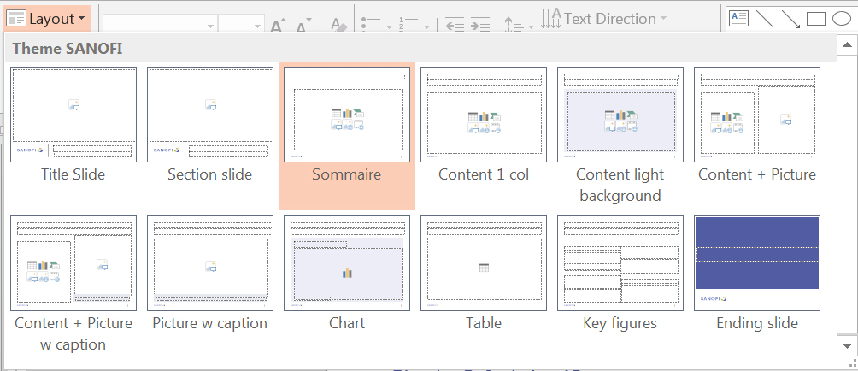
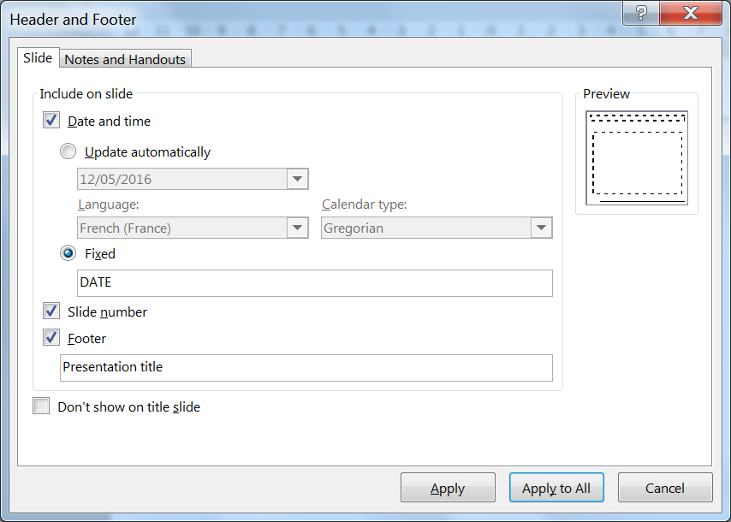
Corporate PowerPoint user guide (1/2)
Typography
The font used is ARIAL. The minimum size for text should be 16 point.
How to replace an image?
Delete the existing image.
Click on the Insert tab, then Pictures.
Select the desired image and adjust if needed.
Add the photo credits credits (name of photographer, images library).
How to insert a new slide?
In the Home tab, click on the down arrow on the side of the New Slide button and choose the desired theme.
How to modify the Footer?
Click on the Insert tab, then Header & Footer.
Insert the text in the Footer text box.
Click the option Don’t show on title page.
Click the option Slide number.
Click on Apply to all.
How to choose the theme of the slide?
Select a slide, click on the Layout button and choose the required theme.

Slide 3
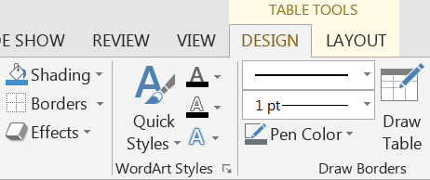
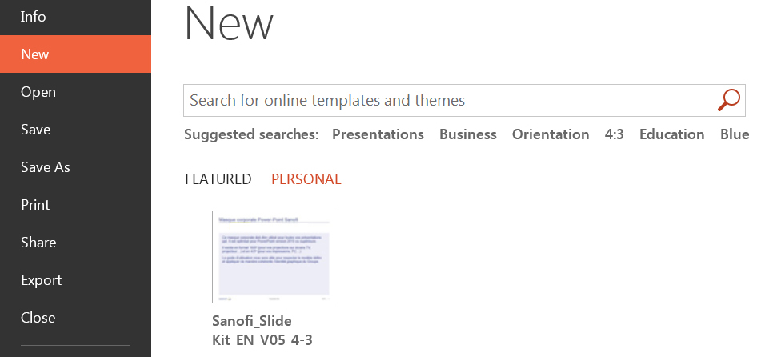

Corporate PowerPoint user guide (2/2)
How to format a table?
Select the line or column.
Click on the Table Design tab.
Click on Shading to modify the color of the line or column.
Click on Pen color then on Borders to modify the borders.
You can insert or delete columns and lines.
To be able to access the corporate template directly, save the template on your computer/System.
Click on the File menu tab, then Save as.
Choose the format .potx (PowerPoint template).
PowerPoint automatically selects Custom Office Templates.
When creating a new presentation, click on New, then on Personal and choose the saved template.
This sequence should be repeated for each work station.
How to create a chart template?
Click on the chart.
Click on Save as Template
When inserting a new chart, click on Template and choose the saved template.
This sequence should be repeated for each work station.
For further information, please contact the Communications department.
Contact: corporate-brand@sanofi.com

Slide 4
Color panel
Main colors available in the master
Theme colors
Colors of the Sanofi’s logo
Secondary colors (extracts from Sanofi’s color panel)
R 82
G 92
B 163
R 188
G 188
B 28
R 202
G 174
B 122
R 62
G 144
B 208
R 143
G 110
B 170
R 190
G 0
B 107
R 0
G 165
B 144
R 71
G 103
B 40
R 107
G 116
B 123

Slide 5

Presentation title, 32 pts
Photo credits: ©
Subtitle, 24 pts

Slide 6

Chapter opening, 32 pts
Photo credits: ©
Subtitle, 24 pts

Slide 7

Chapter opening, 32 pts
Photo credits: ©
Subtitle, 24 pts

Slide 8

Chapter opening, 32 pts
Photo credits: ©
Subtitle, 24 pts

Slide 9

Chapter opening, 32 pts
Photo credits: ©
Subtitle, 24 pts

Slide 10
Contents, 28 pts
Chapter 1, 18 pts XX
Sub-Chapter, 16 pts
Chapter 2, 18 pts XX
Sub-Chapter, 16 pts
Chapter 3, 18 pts XX
Sub-Chapter, 16 pts
Chapter 4, 18 pts XX
Sub-Chapter, 16 pts
Chapter 5, 18 pts XX
Sub-Chapter, 16 pts
Chapter 6, 18 pts XX
Sub-Chapter, 16 pts

Slide 11
Contents, 28 pts, color version
Chapter 1, 18 pts XX
Sub-Chapter, 16 pts
Chapter 2, 18 pts XX
Sub-Chapter, 16 pts
Chapter 3, 18 pts XX
Sub-Chapter, 16 pts
Chapter 4, 18 pts XX
Sub-Chapter, 16 pts
Chapter 5, 18 pts XX
Sub-Chapter, 16 pts
Chapter 6, 18 pts XX
Sub-Chapter, 16 pts

Slide 12
Slide – text – 1 column, 28 pts
Subtitle, 22 pts
Text - level 1, 20 pts
Text - level 2, 18 pts
Text - level 3, 16 pts
Text - level 1, 20 pts
Text - level 2, 18 pts
Text - level 3, 16 pts

Slide 13
Slide 1 column 28 pts
Subtitle, 22 pts
Text - level 1, 20 pts
Text - level 2, 18 pts
Text - level 3, 16 pts
Text - level 1, 20 pts
Text - level 2, 18 pts
Text - level 3, 16 pts

Slide 14

Slide – text – 1 photo, 28 pts
Subtitle, 22 pts
Text - level 1, 20 pts
Text - level 2, 18 pts
Text - level 3, 16 pts
Text - level 1, 20 pts
Text - level 2, 18 pts
Text - level 3, 16 pts
Photo credits: ©

Slide 15
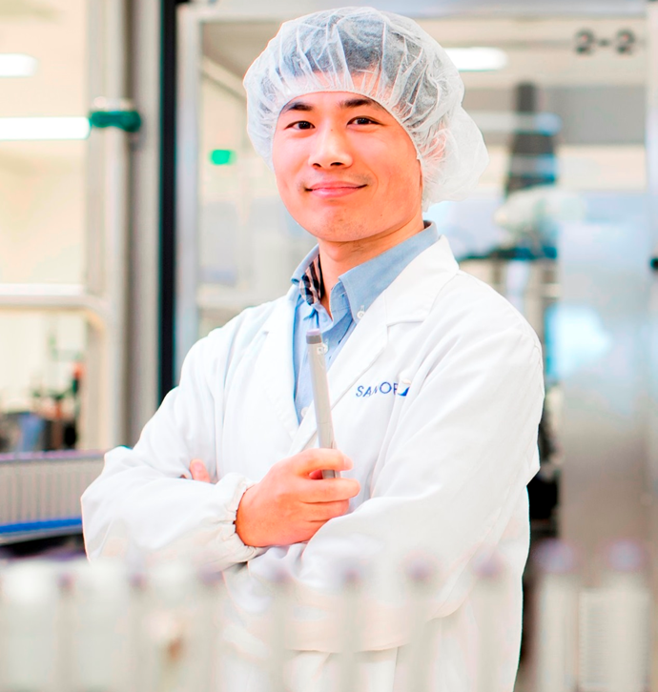
Slide – text – 1 photo with caption, 28 pts
Subtitle, 22 pts
Text - level 1, 20 pts
Text - level 2, 18 pts
Text - level 3, 16 pts
Text - level 1, 20 pts
Text - level 2, 18 pts
Text - level 3, 16 pts
Caption, 14 pts

Slide 16
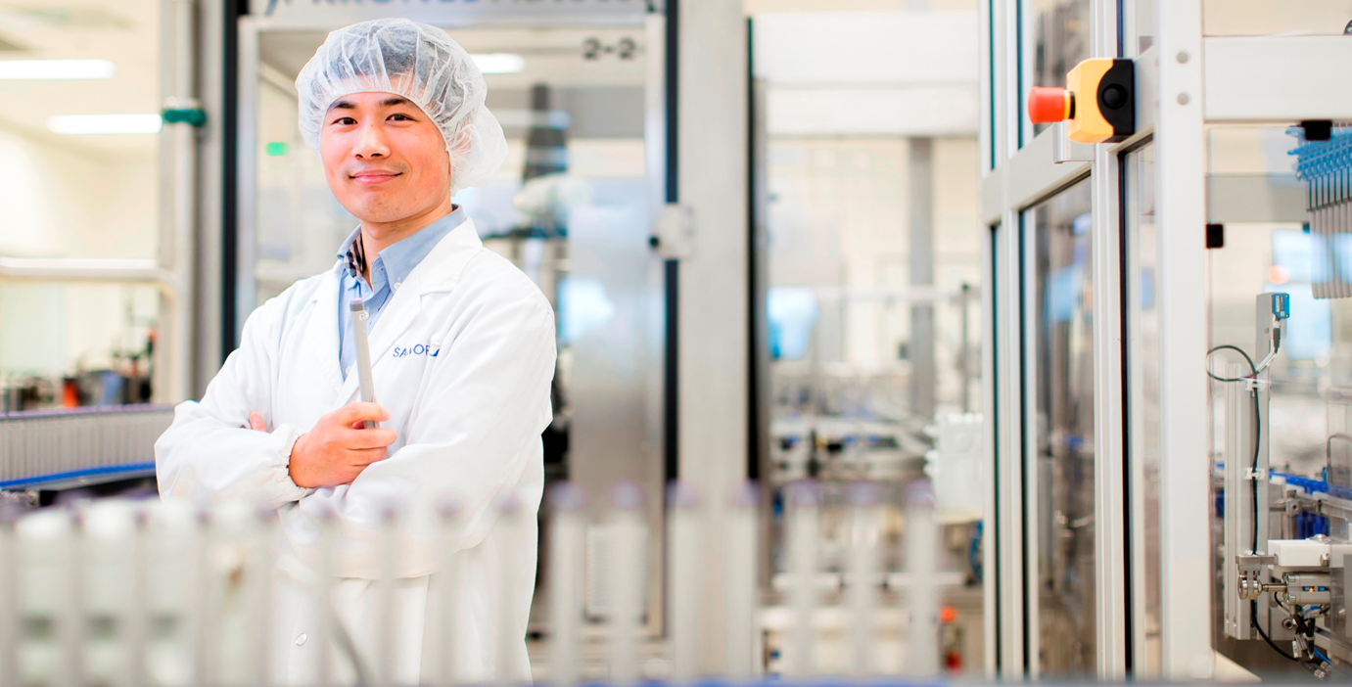
Slide – 1 photo with caption, 28 pts
Subtitle, 22 pts
Photo credits: ©
Caption, 14 pts

Slide 17
Slide – pie chart, 28 pts
Subtitle, 22 pts
Chart title 20 pts
Source:

Slide 18
Slide – line chart, 28 pts
Subtitle, 22 pts
Chart title 20 pts
Source:

Slide 19
Slide – column chart, 28 pts
Subtitle, 22 pts
Chart title 20 pts
Source:

Slide 20
Slide – table, 28 pts
Subtitle, 22 pts
Heading | Heading | Heading | Heading | Heading
Table text | XX | XX | XX | XX
Table text | XX | XX | XX | XX
Table text | XX | XX | XX | XX
Table text | XX | XX | XX | XX
Table text | XX | XX | XX | XX
Table text | XX | XX | XX | XX
Table text | XX | XX | XX | XX
Table text | XX | XX | XX | XX
Table text | XX | XX | XX | XX
Table text | XX | XX | XX | XX

Slide 21
Slide – table, 28 pts
Subtitle, 22 pts
Heading | Heading | Heading | Heading | Heading
Table text | XX | XX | XX | XX
Table text | XX | XX | XX | XX
Table text | XX | XX | XX | XX
Table text | XX | XX | XX | XX
Table text | XX | XX | XX | XX
Table text | XX | XX | XX | XX
Table text | XX | XX | XX | XX
Table text | XX | XX | XX | XX
Table text | XX | XX | XX | XX
Total | XX | XX | XX | XX

Slide 22
Slide – table, 28 pts
Subtitle, 22 pts
Heading | Heading | Heading | Heading | Heading
Table text | XX | XX | XX | XX
Table text | XX | XX | XX | XX
Table text | XX | XX | XX | XX
Table text | XX | XX | XX | XX
Table text | XX | XX | XX | XX
Table text | XX | XX | XX | XX
Table text | XX | XX | XX | XX
Table text | XX | XX | XX | XX
Table text | XX | XX | XX | XX
Table text | XX | XX | XX | XX

Slide 23
Slide – table, 28 pts
Subtitle, 22 pts
Heading | Heading | Heading | Heading | Heading
Table text | XX | XX | XX | XX
Table text | XX | XX | XX | XX
Table text | XX | XX | XX | XX
Table text | XX | XX | XX | XX
Table text | XX | XX | XX | XX
Table text | XX | XX | XX | XX
Table text | XX | XX | XX | XX
Table text | XX | XX | XX | XX
Table text | XX | XX | XX | XX
Total | XX | XX | XX | XX

Slide 24
Slide – table, 28 pts
Subtitle, 22 pts
Heading | Heading | Heading | Heading | Total
Table text | XX | XX | XX | XX
Table text | XX | XX | XX | XX
Table text | XX | XX | XX | XX
Table text | XX | XX | XX | XX
Table text | XX | XX | XX | XX
Table text | XX | XX | XX | XX
Table text | XX | XX | XX | XX
Table text | XX | XX | XX | XX
Table text | XX | XX | XX | XX
Table text | XX | XX | XX | XX

Slide 25
Slide – key figures, 28 pts
Subtitle, 22 pts
Cor aut et voloreratem
XXXX
XXX
Icaborporae mo mint
Lo icaborporae ra
evelique nonecto
XX %
Cor aut et voloreratem
XXX
Icaborporae mo mint
Lo icaborporae

Slide 26
Slide – key figures, 28 pts
Subtitle, 22 pts
Cor aut et voloreratem
XXXX
XXX
Icaborporae mo mint
Lo icaborporae ra
evelique nonecto
Sumqui nusa qui
Corumentisim non nistrum
Illustration
Illustration
Illustration
Illustration
Illustration
Illustration
Illustration

Slide 27
Slide – key figures, 28 pts
Cor aut et voloreratem
XXXX
XXX
Icaborporae mo mint
Lo icaborporae ra
evelique nonecto
Sumqui nusa qui
Corumentisim non nistrum
Illustration
Illustration
Illustration
Illustration
Illustration
Illustration
Illustration

Slide 28
THANK YOU

